Slide 1
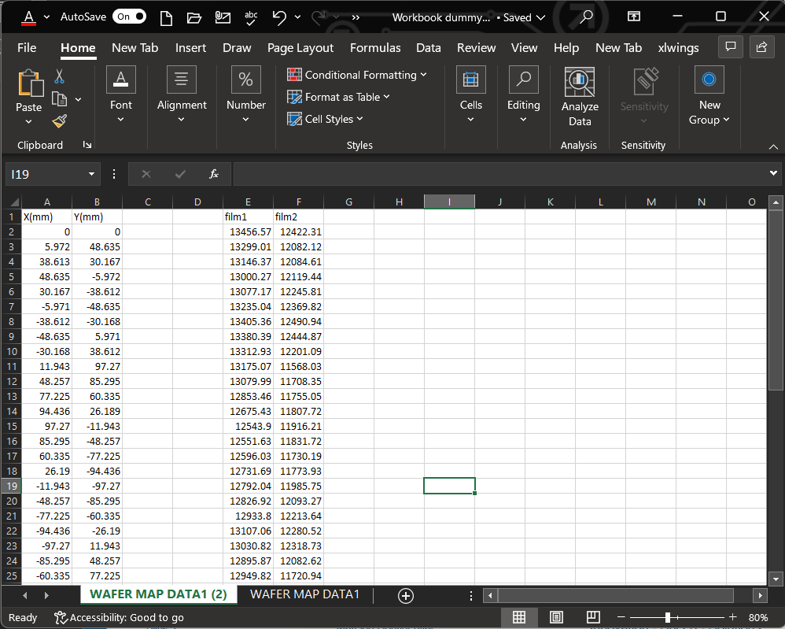
Step1: Preparing Dataset.
The app uploads data through two ways: a) datasets that are built up with (x, y, data1, data2, …), and b) the measurement data that are exported from Atlas metrology tools from Nano Metrics.
For setting up a dataset, Copy/Paste raw data into Excel or CVS sheet.
Column A and B are reserved for (x, y) coordination. All other columns are for measurement data.
Contents in the first row doesn’t affect potting. You may want to put notes on there.
There is no limit for the number of data columns can be used.
Closed the data sheet before uploading from the app otherwise it won’t be working.
Don’t put anything on unoccupied cells to avoid confusing the app.

Slide 2
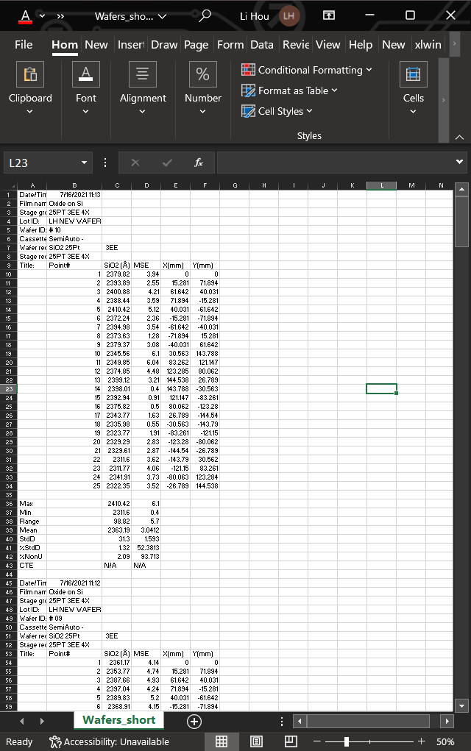
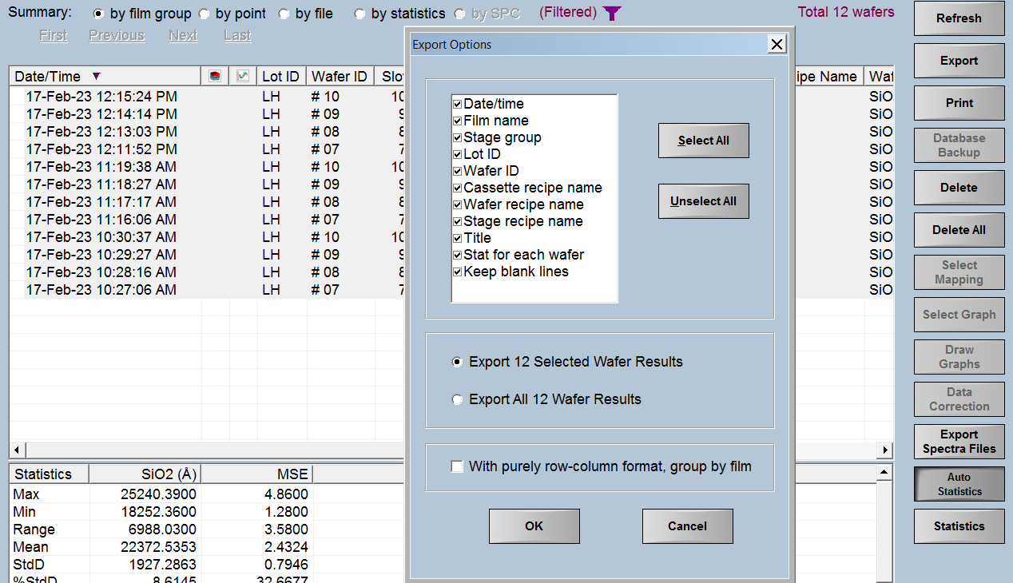
Step1: Or Exporting Atlas Data.
On Atlas screen click “Export” and then “Select All” button as the image shown below.
Using Excel to open the data as the image shown in the right.
It is okey saving the data in either .csv or .xls format.
Closed the data sheet before uploading from the app otherwise it won’t be working.

Slide 3
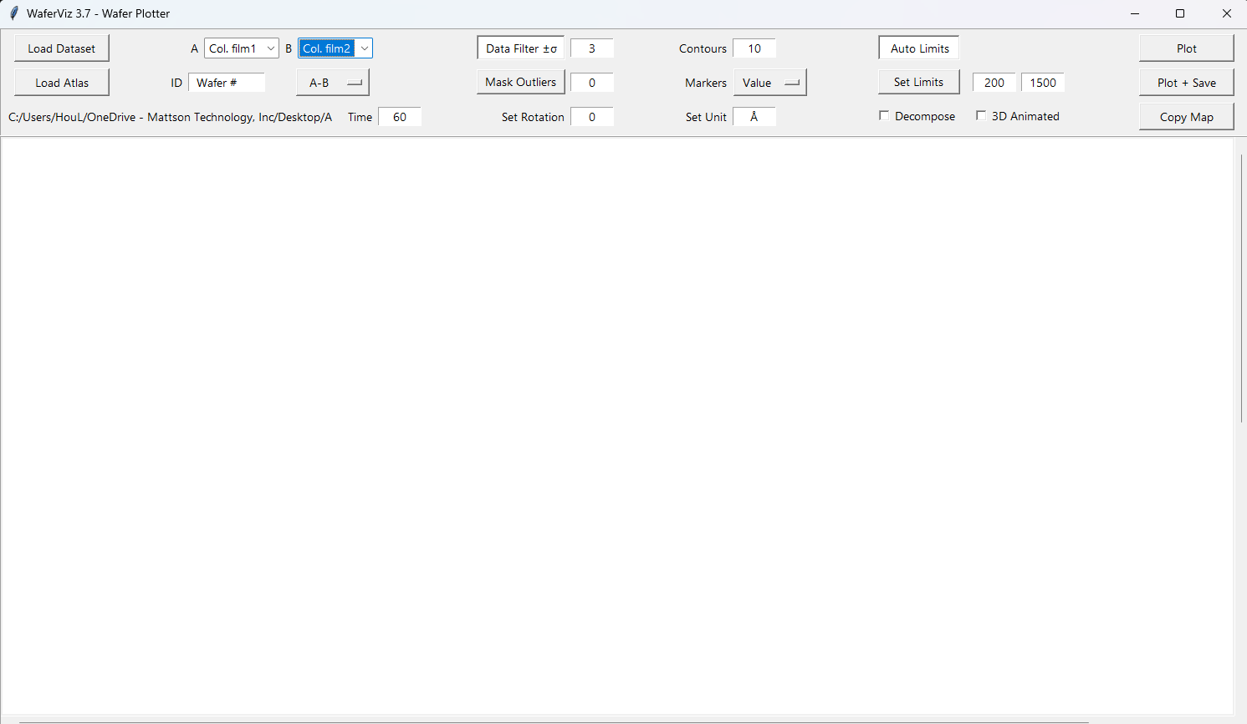
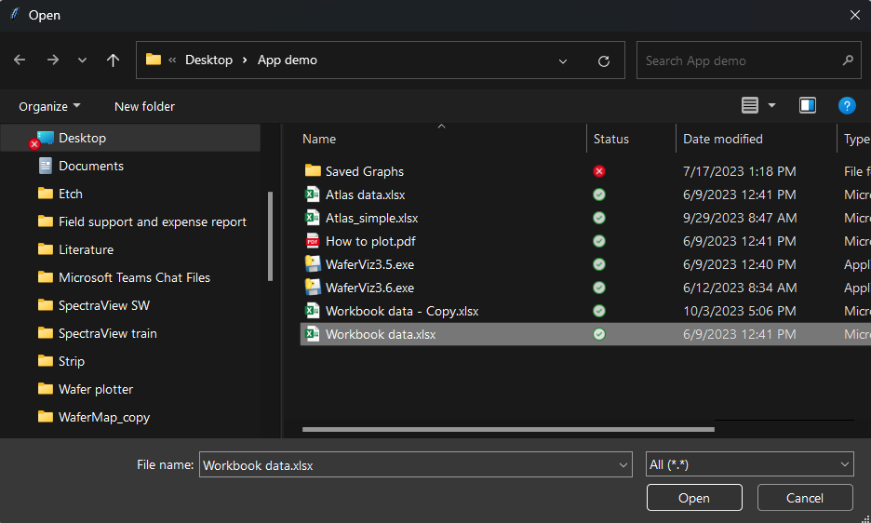
Step2: Uploading the Data.
Open the app and load either dataset or Atlas data by clicking buttons.

Slide 4
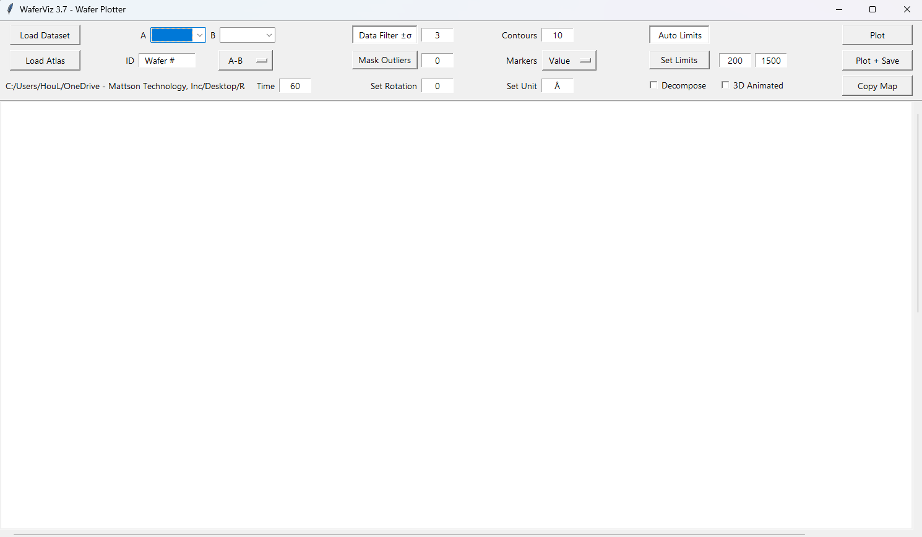


Step3: Select Wafers and Configure Plotting.
2
8
6
11
3
4
7
9
1
5
10
The path to files.
A, B can be two films of pre-process and post-process.
You can enter the ID.
See right side.
You can enter process time to get rates but need to select (A-B)/t or (B-A)/t to be effective.
Default data filter is set ±3σ. Beyond that the data points will be excluded. The number of excluded points is shown in the contour map.
If “Mask Outliers” is pressed, you can find sigma value in the contour map according to the number of points you’ve removed.
You can enter the number of contours from 1 to 100 for the contour map.
See right side.
The default unit is Å. You can change it to any physical units such as °C, Ohm/sq.
If “Set Limits” is pressed, You can enter lower limit and up limit that will be in effect.
4. Operators:
9. Marker choices for the contour map:

Slide 5
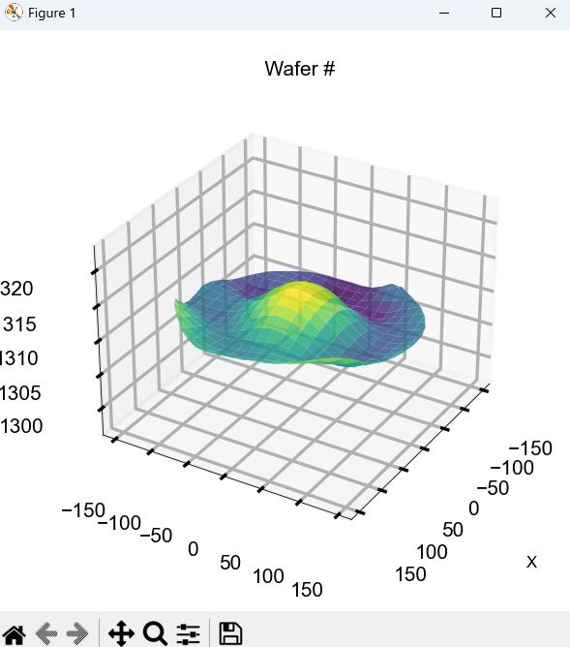
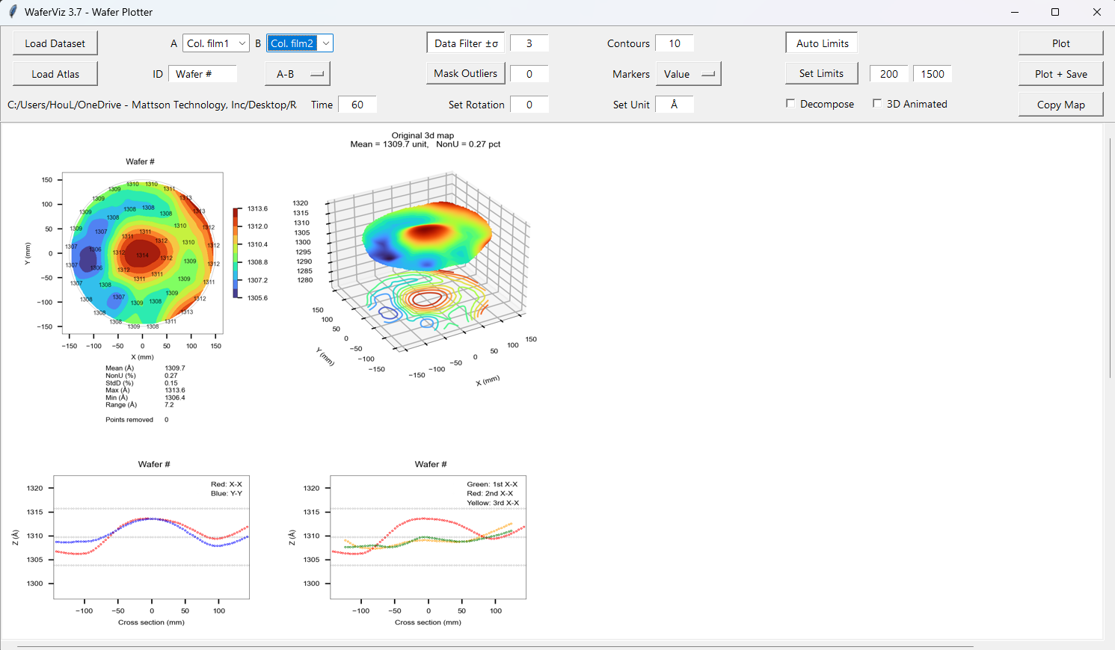
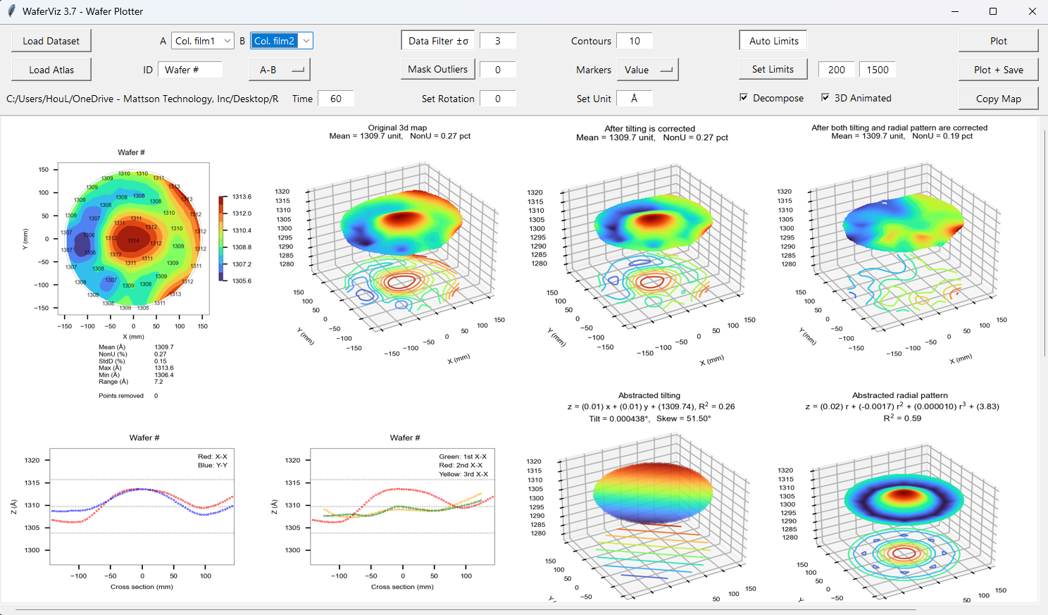
Step4: Plot.
Just plotting only takes few seconds.
Selecting “Decompose” and “3D Animated” and “Plot” will take 22s.

Slide 6
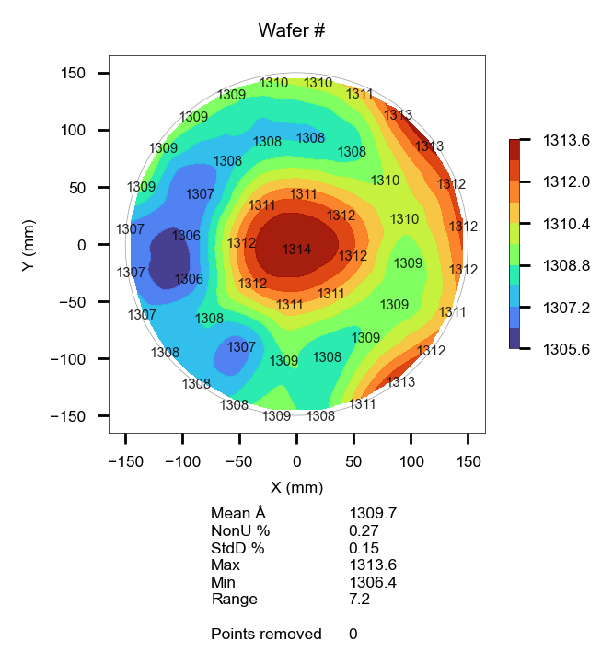

Step5: Copy the Graph
After graphs are plotted, clicking “Copy Map” will copy contour map into Windows’ clipboard which allows you to paste it to other apps.

Slide 7
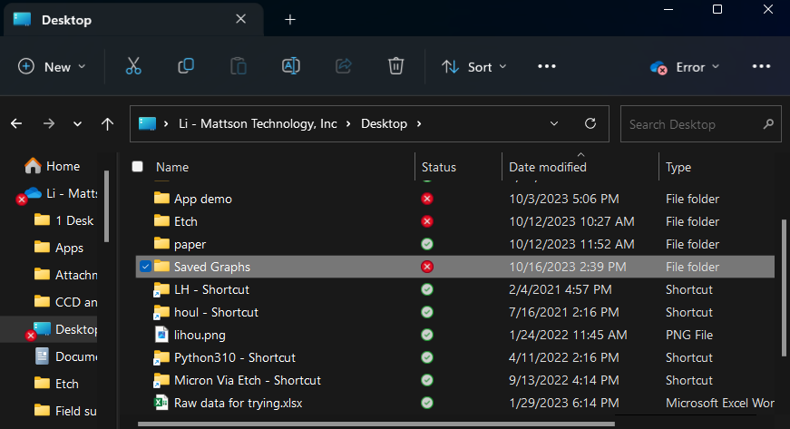
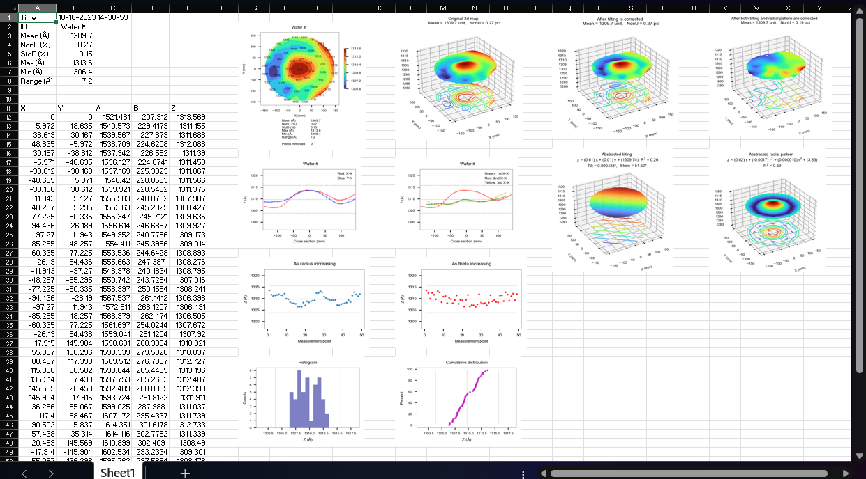
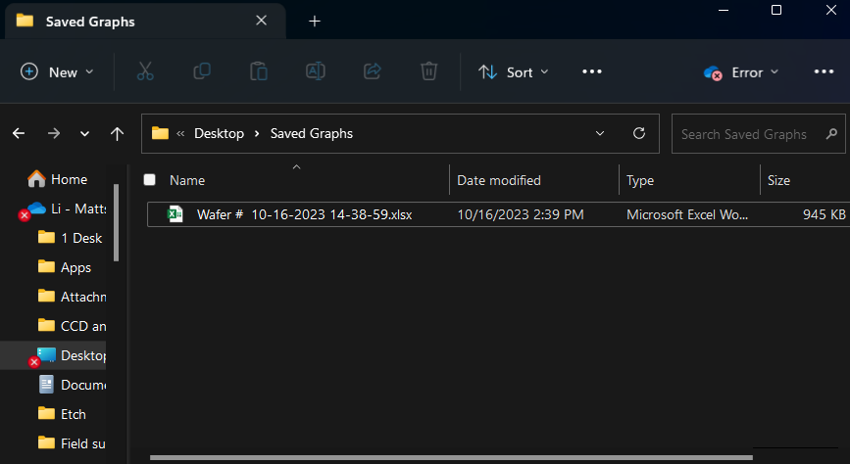
Step5: Save Graphs
Clicking “Plot + Save” adds an Excel summary sheet in auto-generated folder “Saved Graphs”.
The folder is in the same location where you have dropped this app into.

